Slide 1
Hypnosis for the treatment of pain and therapy
An Outline

Slide 2
Pain
Acute or chronic?

Slide 3
Standard techniques
Relaxation
Pain dial
Glove anaesthesia
Endorphin reservoir
Distraction
Dissociation

Slide 4
Relaxation
Underpins all the other techniques
Relaxation per se reduces the pain experience
Use a relaxing induction
Be relaxed yourself

Slide 5
The Pain Dial
Useful to show fMRI scans
All pain is real
Change is possible
Techniques simple

Slide 6
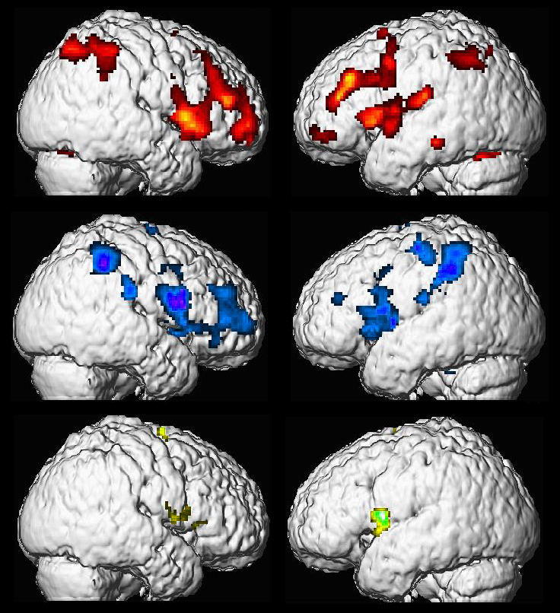
Functional pain
Physically-induced pain
Hypnotically-induced pain
Imagined pain

Slide 7
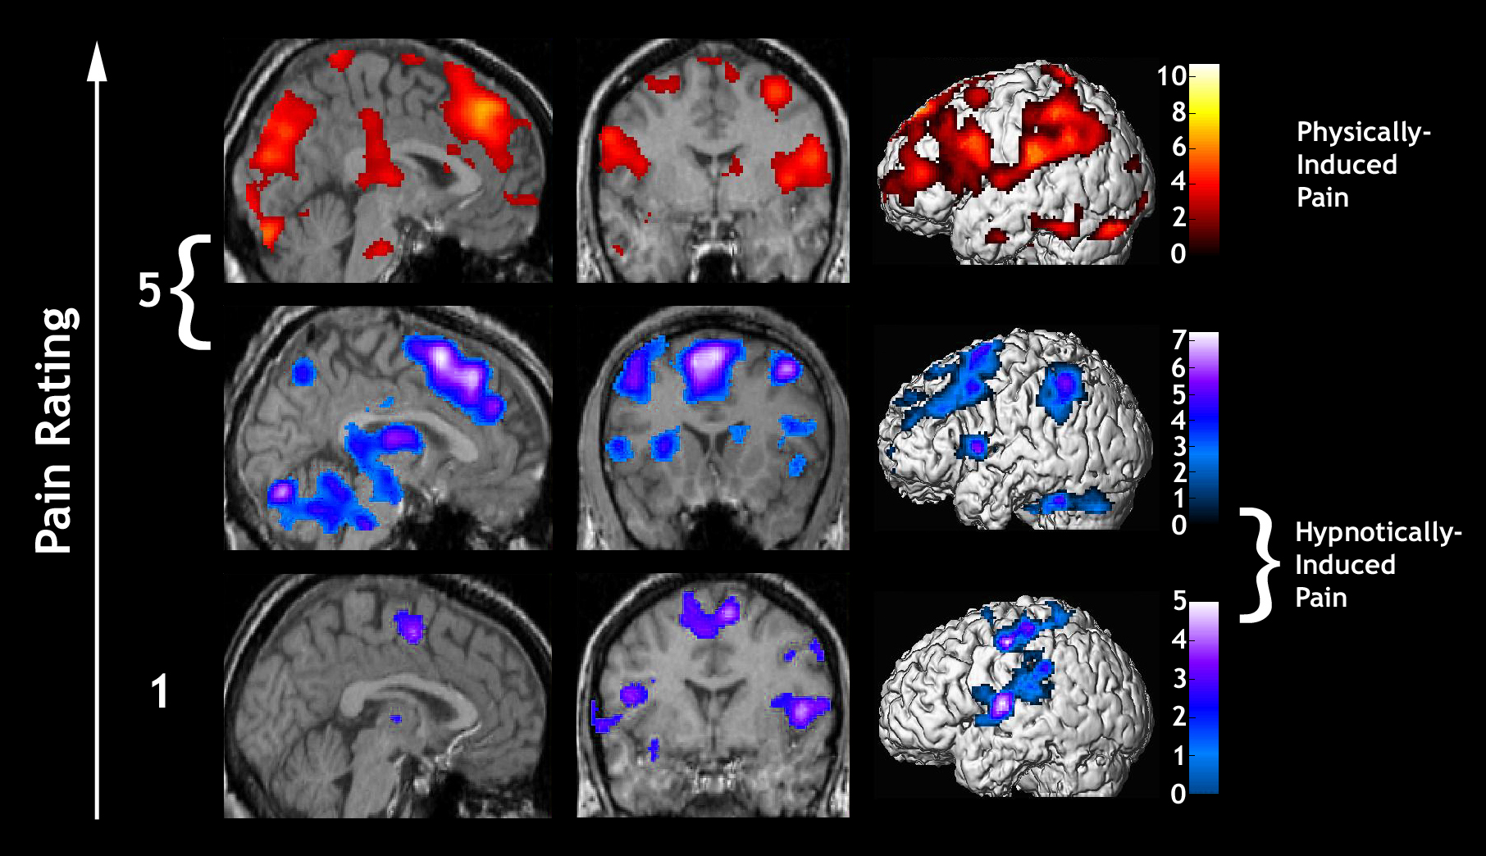
Functional pain

Slide 8
Pain Dial
Induce hypnosis by any method
Ask to picture that part of their mind which measures how painful something is – see the dial
Turn it down
Can use paradoxical injunction: ask them to turn it up first before turning it down

Slide 9
Glove anaesthesia
Hypnotize
Suggest hand repeatedly dipped into cold water/ fridge etc
When hand numb can transfer to painful area.

Slide 10
Endorphin reservoir
Explain endorphins are our natural pain killers
Hypnotize
Picture a tank with endorphin
Open tap and let soothing fluid flow over painful area reducing pain and giving euphoric glow
Useful in obstetrics

Slide 11
Distraction
This is simply getting the patient to focus on something other than the pain
Mental arithmetic
Describe a nice place – best if they talk through the detail rather than just picture it
Useful for procedures and doesn’t necessarily need a formal hypnosis induction
While you’re telling me about it what we are doing ‘won’t bother you at all’

Slide 12
Dissociation
Tends to need a good hypnotic subject
The pain (or part of the body with the pain) is away from themselves and it seems as though the pain is happening elswhere

Slide 13
Corrective imagery
The patient is asked – in hypnosis – to go into the pain and describe what it is like. Shape, size, colour etc
Suggestions are then given to change the appearance: shrink it, change colour etc until the pain feels more comfortable

Slide 14
Chronic Pain and other ‘hypnotherapy’
Chronic pain and other functional problems often occurs in the absence of any discernible physical disease.
Important not to go directly for symptom removal
Need to explore the underlying cause(s)
Frequently resolving the underlying problem leads to resolution of the symptoms.

Slide 15
Hypnotherapy
History of the problem:
When did it start
What was happening at the time
What investigations
What were you told
Explain hypnosis
Best to use a left/right hemisphere model

Slide 16
Hypnotherapy
Under hypnosis:
Explore the problem
Identify the cause
Resolve the problem
Check that it is ok to do so – secondary gain??
Then tackle symptoms if still present
Mentally rehearse how they are without the problem
Dehypnotize

Slide 17
Remember!
Always work within your area of competence
Refer on if you find yourself out of your depth
Many of the functional disorders result from some sort of trauma (physical, sexual, emotional)
BUT…..
NEVER suggest that such a thing must have happened
False memories can easily be created

